Slide 1
Design Patterns
Prof. Dr. Dirk Riehle
Friedrich-Alexander University Erlangen-Nürnberg
ADAP C07
Licensed under CC BY 4.0 International
Notes:
It is Friedrich-Alexander University Erlangen-Nürnberg – FAU, in short.
Corporate identity wants us to say “Friedrich-Alexander University”.

Slide 2
Agenda
Three example designs
Composite design pattern
Design patterns
Levels of abstraction
Describing design patterns
Applying design patterns
As a language feature

Slide 3
1. Three Example Designs

Slide 4
Three Examples
File / Directory
Position / Portfolio
TestCase / TestSuite

Slide 5
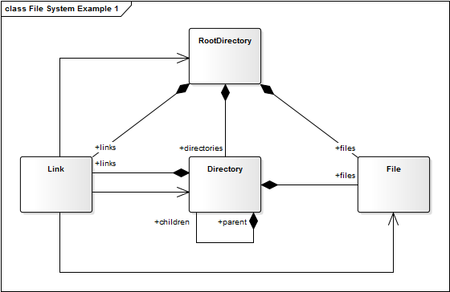
File / Directory Example 1 / 3

Slide 6
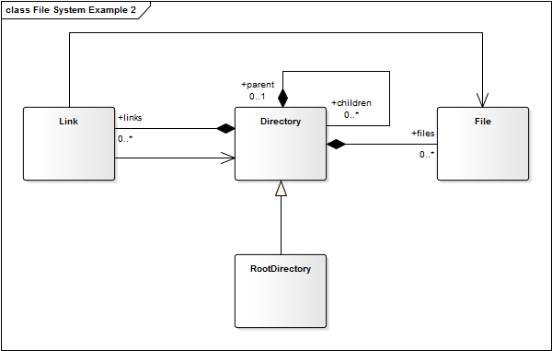
File / Directory Example 2 / 3

Slide 7
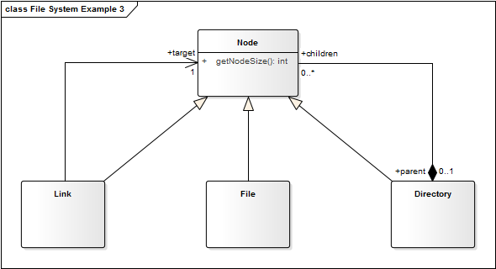
File / Directory Example 3 / 3

Slide 8
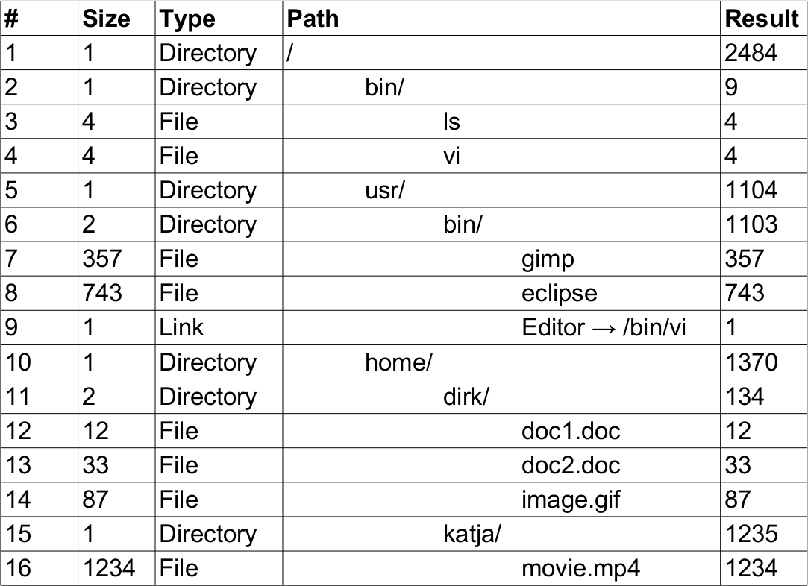
File / Directory Exercise

Slide 9
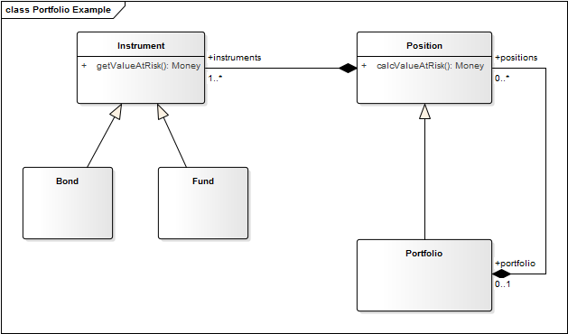
Position / Portfolio Example

Slide 10
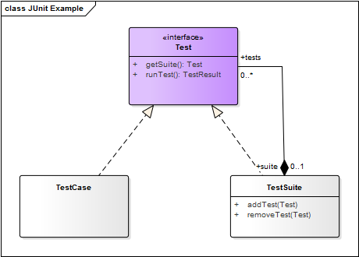
TestCase / TestSuite Example

Slide 11
2. Composite Design Pattern

Slide 12

Composite Structure Diagram (Original)

Slide 13
Quiz: Configuring a Computer
You are configuring a computer. The computer consists of parts. Some parts are atomic (a keyboard, a memory bank, a hard disk), some are composite (memory subsystem, storage subsystem, video subsystem), meaning you can configure its parts.
Using the Composite design pattern, how would you design a class hierarchy to represent a computer configuration?
  Each type of atomic part is represented as its own class.
  Each type of composite part is represented as its own class.
  All part classes are direct subclasses of an abstract Part class.

Slide 14
Answer 1 / 2: Configuring a Computer

Slide 15
Answer 2 / 2: Configuring a Computer
How would you design a class hierarchy to represent a computer configuration?
  Each type of atomic part is represented as its own class.
    Yes. Different types of objects should be represented as different classes.
  Each type of composite part is represented as its own class.
    Yes. Different types of objects should be represented as different classes.
  All part classes are direct subclasses of an abstract Part class.
    No. Having a Part class makes sense, but there will be many part classes that will not be direct subclasses. An example are the classes for the specific types of subsystems.

Slide 16
3. Design Patterns

Slide 17
Definition of Design Pattern
The abstraction of a common solution to a recurring problem for a given context. [DR]

Slide 18
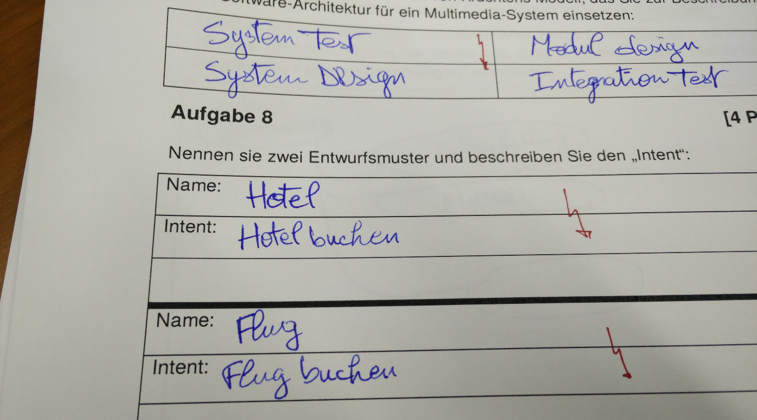
From a Written Exam

Slide 19
Benefits of Using Design Patterns
Faster, better, cheaper …
designing of software
documenting software
communicating designs

Slide 20

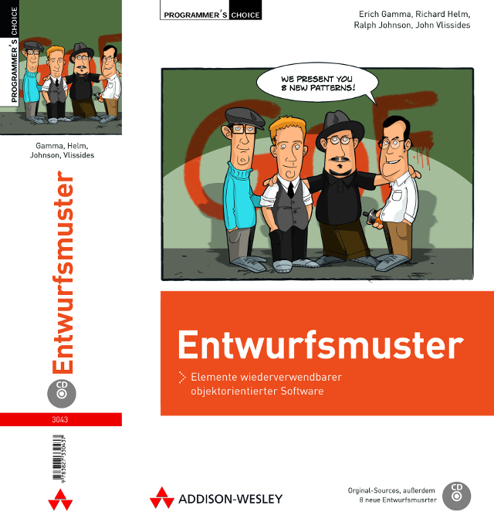
The Design Patterns (“Gang-of-Four”) Book

Slide 21
Highly Abridged History of Design Patterns
A Pattern Language
“No Object is an Island”
ET++ and Interviews
Design Pattern Catalog
A System of Pattern

Slide 22
4. Levels of Abstraction

Slide 23
Levels of (Design) Patterns
Architectural Patterns [1]
Design Patterns
Programming Idioms
[1] A.k.a. architectual style

Slide 24
Example of an Architectural Pattern
Publish / Subscribe Architecture
  Purpose
    Create a system that can be
      easily extended and
      evolved at runtime
  Components
    Events: Data structures that capture a particular event
    Publishers: Provide (and possibly create) events to the system
    Subscribers: Receive events from publishers
    Event Channels: Link subscribers to publishers
  Examples
    Linda (historic)
    MQSeries (current)
    ESB (whole category)

Slide 25
Example of a Programming Idiom
public class Counter {
protected int count = 0;
public synchronized int getNext() {
return count++;
}
...
}

Slide 26
5. Describing Design Patterns

Slide 27
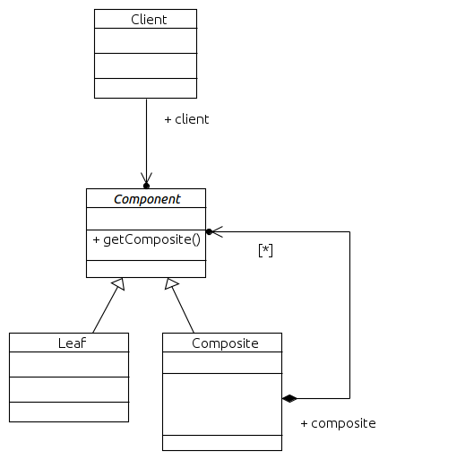
Describing Design Patterns 1 / 2
Problem: How to design a uniform yet flexible object hierarchy?
Context: You need an object hierarchy that you want to handle in a uniform way yet extend it dynamically. Frequently, algorithms need to run over the hierarchy.
Solution: Separate container functionality from domain behavior. Create a container class that can manage, at runtime, components of a generic type. Create all domain-specific classes separately. Make all classes implement the generic component protocol.

Slide 28
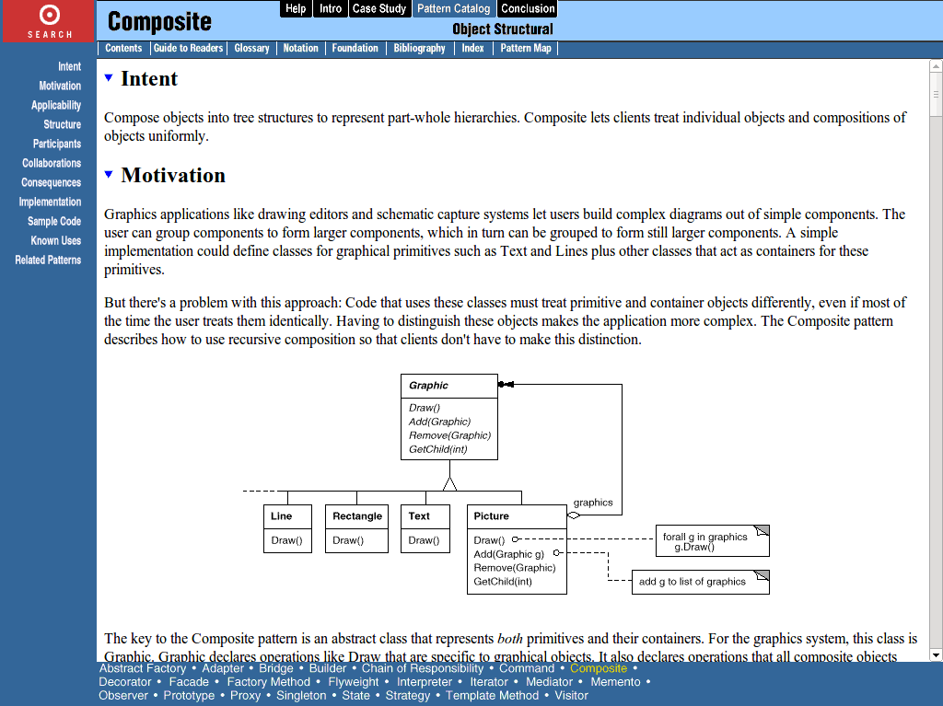
Design Pattern Description Formats 2 / 2

Slide 29
Collections of Design Patterns
Pattern Collections
Pattern Handbooks
Pattern Languages

Slide 30
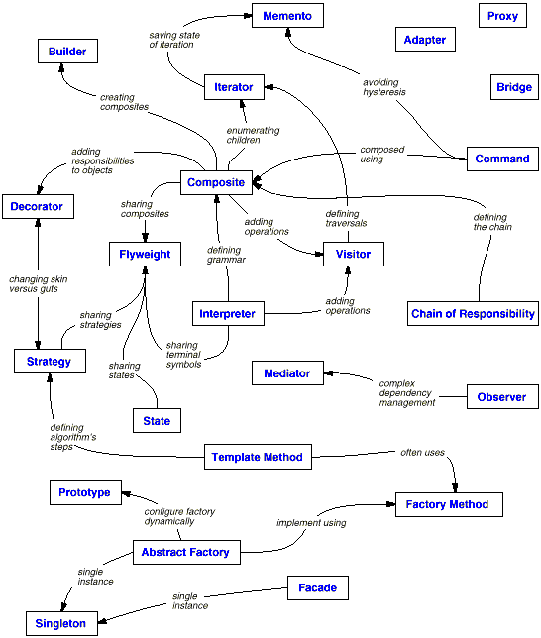
Design Pattern Map

Slide 31
6. Applying Design Patterns

Slide 32
Applying Design Patterns
By-hand Instantiation
As a Design Template
As a Language Feature

Slide 33
Design Pattern vs. Instance (Model)
Pattern
  Illustration, not a model
  Generic terms, for example
    Component, Composite, Leaf
    getComponent, addComponent
Instance
  A specific model (UML, code)
  Specific terms, for example
    Test, TestCase, TestSuite
    run, addTest, getTests

Slide 34
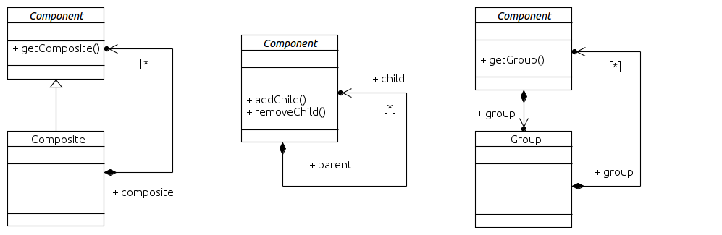
Design Pattern vs. Template

Slide 35
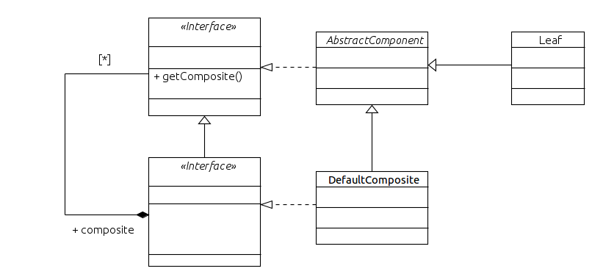
Design vs. Implementation

Slide 36
Quiz: Abstraction Levels
You are looking at a class diagram with class names like KeyboardPart, MemorySub-system, and GraphicsCard.
What type of model does the class diagram most likely represent?
  A design pattern
  A design template
  An implementation

Slide 37
Answer: Abstraction Levels
The class diagram represents most likely what type of model?
  A design pattern
    No. A design pattern (illustration of possible class models) should not contain application-specific class names.
  A design template
    No. A design template (class model for copying) should not contain application-specific class names.
  An implementation
    Yes. Application-specific class names indicate an implementation of a design pattern.

Slide 38
Singleton Example 1 / 2
public class PhotoFactory {
private static PhotoFactory instance = new PhotoFactory();
public static PhotoFactory getInstance() {
return instance;
}
protected PhotoFactory() {
// do nothing
}
...
}

Slide 39
Singleton Example 2 / 2
public class PhotoFactory {
private static PhotoFactory instance = null;
public static synchronized PhotoFactory getInstance() {
if (instance == null) {
setInstance(new PhotoFactory());
}
return instance;
}
protected static synchronized void setInstance(PhotoFactory pf) {
assert instance == null;
assert pf != null;
instance = pf;
}
protected PhotoFactory() {
// do nothing
}
...

Slide 40
7. As a Language Feature

Slide 41
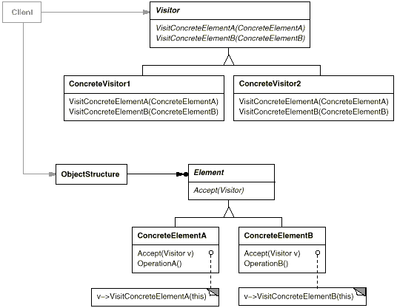
As a Programming Language Feature
Double dispatch, for example: draw(device, figure);

Slide 42
Java Annotation Type for Design Patterns
@interface DesignPattern {
String name();
String[] participants();
}

Slide 43
Annotated File / Directory Example
@DesignPattern {
name = "Composite",
participants = { "Component" }
}
public class Node { ... }
@DesignPattern {
name = "Composite",
participants = { "Composite" }
}
public class Directory extends Node { ... }
@DesignPattern {
name = "Composite",
participants = { "Leaf" }
}
public class File extends Node { ... }

Slide 44
Summary
Three example designs
Composite design pattern
Design patterns
Levels of abstraction
Describing design patterns
Applying design patterns
As a language feature

Slide 45
Thank you! Questions?
dirk.riehle@fau.de – https://oss.cs.fau.de
dirk@riehle.org – https://dirkriehle.com – @dirkriehle
DR

Slide 46
Legal Notices
License
  Licensed under the CC BY 4.0 International License
Copyright
  © 2012-2021 Dirk Riehle, some rights reserved

